Slide 1
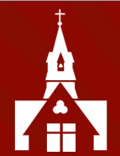
Welcome to the Year 6
Curriculum
Information Evening

Slide 2

Year 6 Team
Miss Bailey (M-F)
Mrs Dench (W am)
Mrs Cronnelly (M-Th)
Mrs Hedley (M-F)
Mrs West (Th pm)
Mrs Redfern (Fri am)
Mrs Denning (Fri pm)

Slide 3
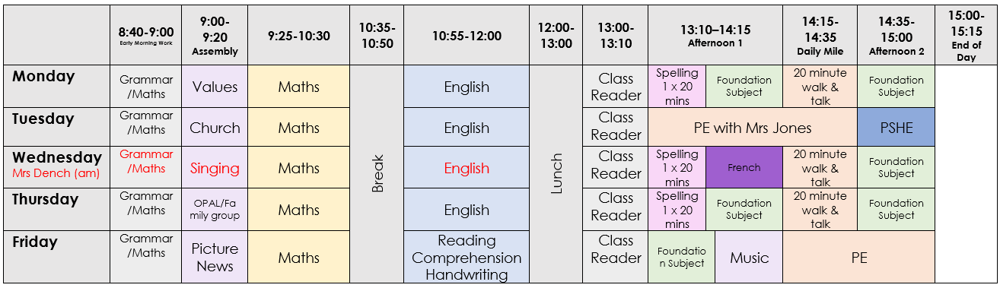
Weekly Timetable

Slide 4
Year 6 – how can that be?!
Please try to support your children with the following:
- organisational expectations
- behavioural expectations
- home learning
- SATs and other assessments
This is so important to ready them for Secondary School in September!

Slide 5
Organisational Expectations
Encourage a routine of completing homework
Handing in homework on time
Reviewing homework
Correct pencil case equipment

Slide 6

Resources

Slide 7
Behavioural Expectations
We expect Year 6 children to:
find solutions to their own problems as far as possible
maintain standards of uniform
show appropriate conduct around the school
take responsibility, show initiative and reliability.

Slide 8
Home Learning
Children should complete the following homework each week:
Spelling Shed games
CGP Arithmetic book (about £4)
Daily reading
Foundation subjects as and when
Home learning will be set on a Friday and will be due in the following Friday
WE WILL NO LONGER BE USING PLANPANION

Slide 9
Year 6 Responsibilities
Lunchtime prefects – 5 prefects per half-term
House Captains
School Council
Family Group Leaders
Church Services (Remembrance, Christingle & Leavers)
Choir choristers
Sports team captains
Please help us to manage your child’s expectations. Unfortunately, we cannot make everyone a House Captain, School Councillor etc… but there are other opportunities for children to look forward to!
Notes:
Previous School Council AY and SK will stay in position. Chair and Vice chair will be announced shortly.

Slide 10
Home Learning from January
In the New Year, home learning will change slightly. CGP book tasks will be set in preparation for SATS. It is crucial that children keep up with this.
More information will be sent out nearer the time.

Slide 11
Spelling
In KS2, we do not set weekly spellings to learn at home for a test. Instead, we use Spelling Shed, which incorporates evidence-based best practices and strategies, to teach and practise spelling.
There are wordlists for years 3 and 4 and years 5 and 6 which are statutory. The lists are a mixture of words pupils frequently use in their writing and those which they often misspell. Some of the listed words may be thought of as quite challenging, but the 100 words in each list can easily be taught within the four years of key stage 2 alongside other words that we consider appropriate.
We are sending home the statutory word lists for the year group for your information. There is no expectation for your children to be tested on these words and please remember that they will be working on them over a two-year period.

Slide 12
SATs Week
Monday 12th May – Thursday 15th May 2024
Maths: 3 papers
arithmetic paper (36 questions in 30 minutes)
2 problem solving papers (40 minutes each)
Reading: 1 comprehension paper (1 hour)
Spelling: 1 paper (20 questions)
Punctuation and Grammar: 1 paper (45 minutes)
Writing – teacher assessed over the year

Slide 13
School Enrichment – we hope!
Skern Lodge (meeting in April)
Sports events
Author workshops and visits
Citizenship Challenge
Moving on programme
First Aid course
The Production – additional costs may apply
In order for these sorts of activities to take place, we do ask for a yearly £30 class contribution to cover extra activities (to be paid by ParentPay). Thank you for your support.

Slide 14
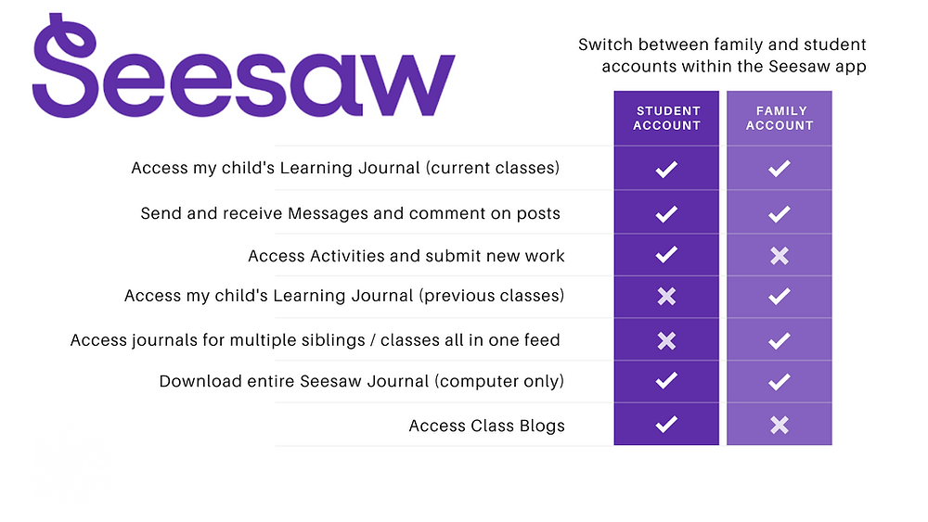
Seesaw is the online learning journal that we will use in every class from Nursery-Year 6. This platform allows us to record learning digitally, set homework tasks to be completed by your child, and provides a home-school connection; families can communicate with their child’s class teacher through the app/account, and teachers can post announcements for family updates. There are two accounts available for Seesaw and you should familiarise yourself with these, so that you choose the correct one for use as a family member.
You have been sent an invitation to connect to your child’s class Seesaw account and, once approved by your child’s class teacher, you will be able to view your child’s learning journal.
Please note, we ask you to use the Seesaw message function respectfully and to only use this to communicate on your child’s learning journey. If you need to communicate with your child’s class teacher for any other reason, please send an email via the school office. admin@christchurchschool.herts.sch.uk
Individual child codes must be used to upload photographs of homework and any other home learning you would like to share with us. A printed QR code has (or will be) provided by the class teacher(s).

Slide 15
Mobile Phones
Mobile Phones – Year 6
Year 6 children who walk to school independently may be given a mobile phone by their parents/carers – this is something each family will decide by themselves. If so, our mobile phone protocol must be followed:
Phones are signed in each morning during registration.
Phones are kept in the school office and collected at the end of each school day.
Phones brought to school must be switched off during the school day.
Internet connectivity must be disabled whilst the phone is in school.
Phones are brought to school at the owner’s own risk and we accept no responsibility for loss or damage.

Slide 16
Safeguarding Children
After school in the village
Online Safety – mobile phones, messaging services, checking your child’s phone

Slide 17
Volunteering at school
We will manage all parent volunteers centrally via the office this year.
Please sign up to any of the roles and we will get in touch with you if your support is required.
Please note, parents will not usually be allocated a volunteer role in their own child’s class.
Thank you so much for your support.

Slide 18

PSA
Thursday 3rd October
8pm online
Hear about the School’s exciting development plan
Find out what we are funding

Slide 19
Thank you for taking the time to listen to this presentation. Please ask us for any further information.

