Slide 1
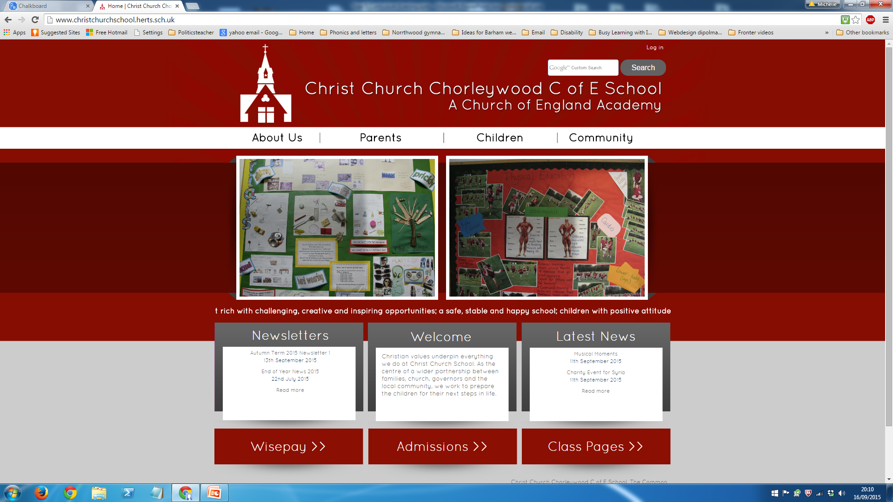
Welcome to the Year 5
Parents’
Information Evening

Slide 2

Year 5 Team
Mrs Roberts
Mrs Auduc-Kelly
Mrs Denning
Mrs Redfern

Slide 3
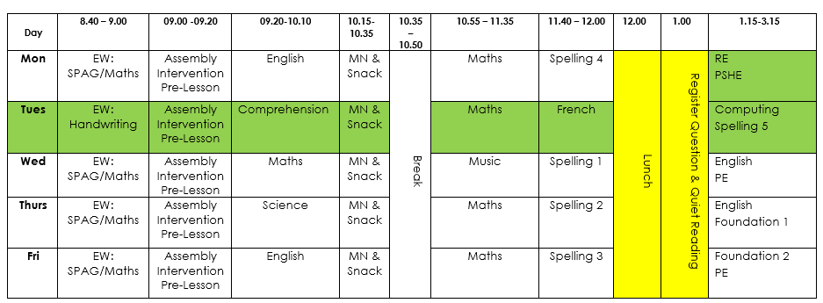
Weekly Timetable

Slide 4











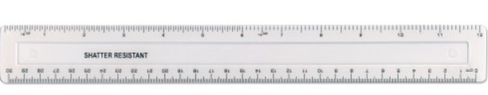
Resources
Equipment required for in class
Year 5 & 6 Pencil Case Equipment
3 HB pencils
Pencil sharpener
Coloured pencils
3 highlighters:
(blue, orange & green)
Eraser
Scissors
Glue
30cm transparent rigid ruler
(not flexible, not with a hinge)
At least 2 frixion pens
(These MUST be named)
1 whiteboard pen
(red, blue, green or black)
1 green biro

Slide 5
Year 5 Curriculum Overview
All objectives for Maths and English are available on our school website.

Slide 6
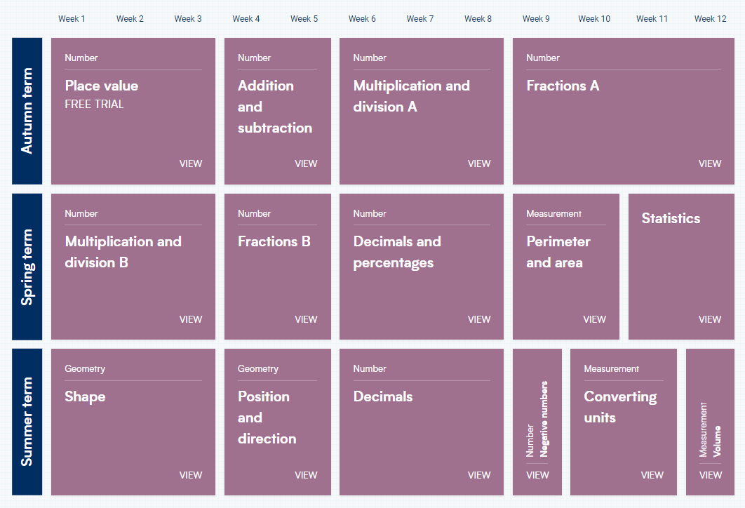
Year 5 Maths Overview

Slide 7
Reading
Your child must read every day.
If your child is on the School Reading Scheme, then Reading Record books should be kept at home and completed by your child every day. They should be brought in to be checked every Friday. Reading books can be changed on any day of the week.
If your child is a free reader, they will fill in a form at school telling us the title of the book they have read.
Please read WITH your child regularly checking for understanding and then sign in the Reading Record for us to see.
Please read TO your child to model reading aloud and expose them to higher level vocabulary and themes.

Slide 8
Spelling
In KS2, we do not set weekly spellings to learn at home for a test. Instead, we use Spelling Shed, which incorporates evidence-based best practices and strategies, to teach and practise spelling.
There are wordlists for years 3 and 4 and years 5 and 6 which are statutory. The lists are a mixture of words pupils frequently use in their writing and those which they often misspell. Some of the listed words may be thought of as quite challenging, but the 100 words in each list can easily be taught within the four years of key stage 2 alongside other words that we consider appropriate.
We are sending home the statutory word lists for the year group for your information. There is no expectation for your children to be tested on these words and please remember that they will be working on them over a two-year period.

Slide 9
Home learning
Going forward we will set the weekly homework on a MONDAY to be completed by the following Monday.
There will be a spelling activity (on Spelling Shed)
Maths (CGP Arithmetic Books?)
TTRS
Daily reading

Slide 10
General Matters
Healthy Eating – substantial snacks of fruit or veg
School Uniform and PE Kits (please provide tape for earrings)
Two pairs of trainers/shoes
On PE days (Wednesday and Friday) children to wear trainers
Communicate via the office

Slide 11
School Enrichment
Leading School Worship (Picture News, weekly)
Weekly Ukulele Lessons with Music Specialist
DT Trip to Woodoaks, Weds 11th December
Woodrow Residential, 12th – 13th March
Cooking, Sewing and Sculpture
Play Leaders (TBC)
Y5 Fun Run
Tag Rugby Tournament
River Chess Trip
Forest School on the Common

Slide 12
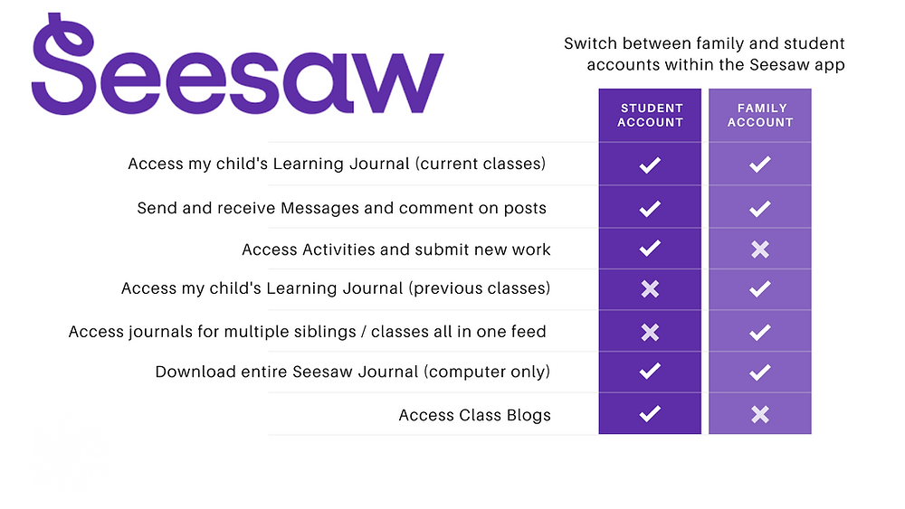
Seesaw is the online learning journal that we will use in every class from Nursery-Year 6. This platform allows us to record learning digitally, set homework tasks to be completed by your child, and provides a home-school connection; families can communicate with their child’s class teacher through the app/account, and teachers can post announcements for family updates. There are two accounts available for Seesaw and you should familiarise yourself with these, so that you choose the correct one for use as a family member.
You have been sent an invitation to connect to your child’s class Seesaw account and, once approved by your child’s class teacher, you will be able to view your child’s learning journal.
Please note, we ask you to use the Seesaw message function respectfully and to only use this to communicate on your child’s learning journey. If you need to communicate with your child’s class teacher for any other reason, please send an email via the school office. admin@christchurchschool.herts.sch.uk
Individual child codes must be used to upload photographs of homework and any other home learning you would like to share with us. A printed QR code has (or will be) provided by the class teacher(s).

Slide 13
Woodrow
12th – 13th March 2025
Drop off on Wednesday at 10am with a packed lunch.
Collection on Thursday 13th at 2pm.
More information to come nearer the time

Slide 14
Mobile phones – parents/carers & visitors
Please remember that mobile phones are not permitted to be used inside the school building by parents/carers and/or visitors when school is in operation, including during after-school clubs.

Slide 15
Volunteering at school
We will manage all parent volunteers centrally via the office this year.
Please sign up to any of the roles and we will get in touch with you if your support is required.
Please note, parents will not usually be allocated a volunteer role in their own child’s class.
Thank you so much for your support.

Slide 16

PSA
Thursday 3rd October
online
Hear about the School’s exciting development plan
Find out what we are funding
Cheese & wine social

Slide 17
Thank you for taking the time to listen to this presentation. Are there any questions?

