Slide 1
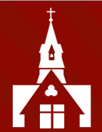
Welcome to the Year 4
Curriculum
Information Evening

Slide 2

Year 4 Team
Miss Parry
Mrs Jones (T am)
Mrs Byde (M-W, F)
Mrs Redfern (M-Th am)
Mrs Welch (Th pm)
Mrs Shaw (F am)

Slide 3
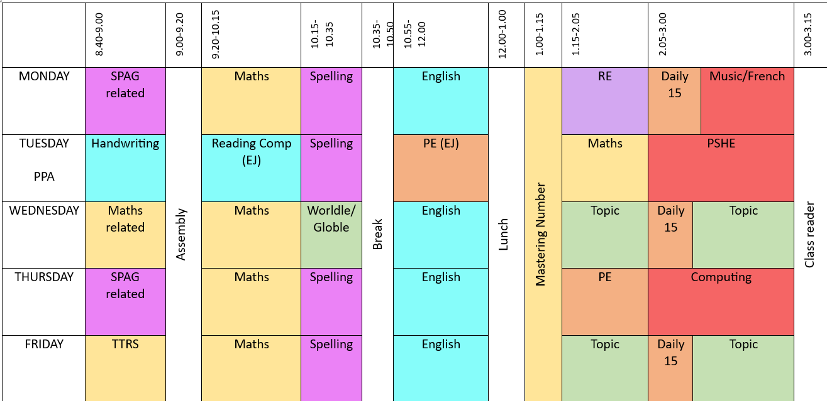
Timetable

Slide 4
Home Learning
Weekly spelling work on Spelling Shed
TTRS – 14 garage games every week
Numbots – 15 minutes a week
  Set on a Friday, and due the following Thursday
Reading every night – Reading books changed on a Thursday

Slide 5
Supporting Your Child
In all home learning, support your child by reminding them to:
Always try their best
Complete their home learning on time
Reflect on their home learning

Slide 6
Reading
Encourage your child to read every day
Please read WITH your child at least two or three times a week, checking for understanding and then sign in the ‘Reading Record’ for us to see
Reading books to be changed on a Thursday
Please also read TO your child
A list of recommended reading for Year 4 is on the school website

Slide 7
Spelling
In KS2, we do not set weekly spellings to learn at home for a test.
Instead, we use Spelling Shed, which incorporates evidence-based best practices and strategies, to teach and practise spelling.
Children need to complete weekly spelling assignments on Spelling Shed as part of their home learning, reflecting in class teaching.

Slide 8
Times Tables/Maths Fluency
The single most helpful thing to support your child’s mathematical learning in Year 4 is to encourage to learn their times tables early and well!
We will use these every single day, and this will be supported by our Mastering Number programme, which builds multiplicative and divisive fluency
Numbots is a fun, game-based way of reinforcing number bonds and basic number facts. The questions may seem easy, but the children’s recall speed will improve through use of the programme

Slide 9



Times Tables – Multiplication Tables Check
Multiplication Tables Check takes places in June
5 minutes to complete
Completed on tablet or computer at school
It is stress free
Results are for teachers
Results are not publicised
There is no pass or fail mark

Slide 10

How You Can Help Your Child?
Practise at Home
Some easy ways to do this include:
asking questions such as “What’s 7 x 8?”
reciting times tables by Rote (4 times 1 is 4, 4 times 2 is 8, etc)
singing times tables songs (there are lots of these online)
Daily TTRS

Slide 11
General Matters
Healthy Eating – fruit only as snacks
Please ensure your children have school lunch that they like!
Water bottles in school
School Uniform and PE Kits
On PE days (Tuesday and Thursday) children to wear trainers and bring in school shoes and spare socks as the weather worsens!
Children need a handwriting pen (blue, Frixion brand) plus spare ink!

Slide 12
Resilient, Independent Learners
Growing maturity – expectations to take responsibility for in class work and home learning
Independence – the children are in control of their learning journeys. They are encouraged to communicate with class adults if they have a query
We will be following the LEANS PSHE programme

Slide 13
Potential School Enrichment
Harvest Service (30th September)
Sports Competitions: Tri Golf (10th October) Dance Festival
Trips
St Albans Cathedral (20th November)
Sailing (June)
Scout-style outdoor activity day (Summer)

Slide 14

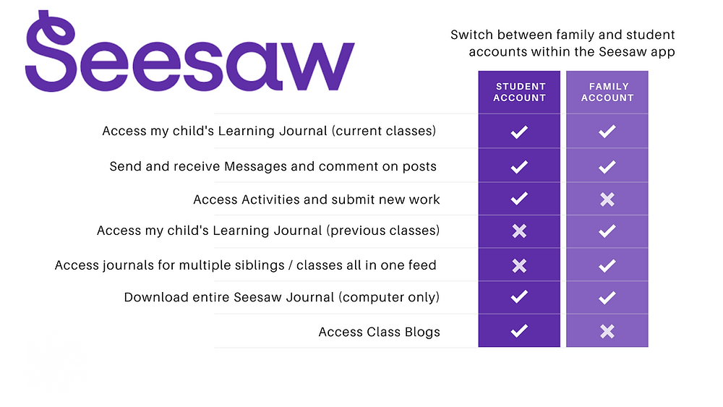
Seesaw learning journal
Seesaw is the online learning journal that we will use in every class from Nursery-Year 6. This platform allows us to record learning digitally, set homework tasks to be completed by your child, and provides a home-school connection; families can communicate with their child’s class teacher through the app/account, and teachers can post announcements for family updates. There are two accounts available for Seesaw and you should familiarise yourself with these, so that you choose the correct one for use as a family member.

Slide 15
Seesaw learning journal
You have been sent an invitation to connect to your child’s class Seesaw account and, once approved by your child’s class teacher, you will be able to view your child’s learning journal.
Please note, we ask you to use the Seesaw message function respectfully and to only use this to communicate on your child’s learning journey. If you need to communicate with your child’s class teacher for any other reason, please send an email via the school office. admin@christchurchschool.herts.sch.uk
Individual child codes must be used to upload photographs of homework and any other home learning you would like to share with us. A printed QR code has (or will be) provided by the class teacher(s).

Slide 16
Mobile Phones – Parents/carers & Visitors
Please remember that mobile phones are not permitted to be used inside the school building by parents/carers and/or visitors when school is in operation, including during after-school clubs.

Slide 17
Voluntary Contributions
The school ask for a voluntary contribution of £10 per term (£30 for the year) per child. This is used to cover various art materials and to provide other resources for the classroom. Payment will be possible towards the end of this week via Arbor. Thank you in advance.

Slide 18
Parent Volunteers
If you would like to volunteer to read with children at school please sign up on the sheet tonight
Your details will be held on a central volunteering record and you could be asked to volunteer in any year group
We may be inundated so please don’t be offended if you don’t get called up!

Slide 19

PSA
Thursday 3rd October
8pm online
Hear about the School’s exciting development plan
Find out what we are funding

Slide 20
Thank you for taking the time to watch and listen to this presentation. Please ask us for any further information.

