Slide 1
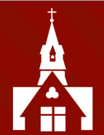
Welcome to the Year 3
Curriculum
Information Evening

Slide 2

Year 3 Team
Miss Jessett
Mrs Welch (TA Wed - Fri)
Ms Edhouse (1:1)
Ms Redfern (1:1)
Mrs Jones (PPA cover)

Slide 3
In your pack…
Seesaw details
TTRS details
Spelling shed details
School photo slip
Year 3/4 statutory spellings

Slide 4
General Matters
Communication with the teacher with be via Seesaw or admin email. Please let me know if you do not want photographs of your child on Seesaw.
Please bring in a healthy snack and water bottle.
School Uniform & PE kits to be worn on the correct days. PE takes place on a Wednesday and a Thursday.

Slide 5
Reading
Children should read everyday. Please make sure that the reading record books are regularly signed and are in your child’s bag so that we can monitor the children’s home reading.
Please read with your child regularly checking for understanding and then sign the book. Please read to your child to model reading aloud and expose them to higher level vocabulary and themes.
Please bring signed reading records and books in on a Wednesday. We will aim to get them home ASAP.
As your child progresses through the reading scheme, the books become longer and you may not get through them in a week. That is absolutely fine! Please only bring back books which you have read and want swapping.

Slide 6
Spellings
In KS2, we do not set weekly spellings to learn at home for a test. Instead, we use Spelling Shed, which incorporates evidence-based best practices and strategies, to teach and practise spelling.
Children will be set games to practice these spellings.
I will also send home the year 3 and 4 statutory spellings. This is a list of words pupils frequently use in their writing and those which they often misspell. There is no expectation for your children to be tested on these words and please remember that they will be working on them over a two-year period.
These words will be taught alongside.
Notes:
some games are quicker than others! open to feedback

Slide 7
Home Learning
Times tables: please complete the times tables set on TTRS.
Garage practice, 14 mins a week (2 mins a day)
End of year 2: 2x, 5x and 10x
End of year 3: above and 3x, 4x and 8x
Reading: please read everyday (checked and swapped on a Wednesday).
Spellings: This year, we are starting a scheme called ‘Spelling Shed’. Children will have spellings in line with our spelling lessons. They are fun online games.

Slide 8
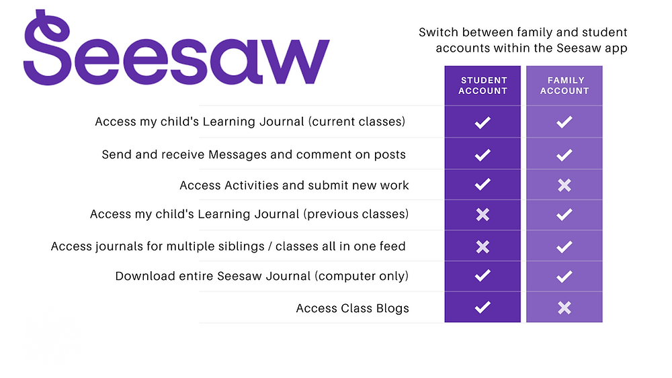
Seesaw is the online learning journal that we will use in every class from Nursery-Year 6. This platform allows us to record learning digitally, set homework tasks to be completed by your child, and provides a home-school connection; families can communicate with their child’s class teacher through the app/account, and teachers can post announcements for family updates. There are two accounts available for Seesaw and you should familiarise yourself with these, so that you choose the correct one for use as a family member.
You have been sent an invitation to connect to your child’s class Seesaw account and, once approved by your child’s class teacher, you will be able to view your child’s learning journal.
Please note, we ask you to use the Seesaw message function respectfully and to only use this to communicate on your child’s learning journey. If you need to communicate with your child’s class teacher for any other reason, please send an email via the school office. admin@christchurchschool.herts.sch.uk
Individual child codes must be used to upload photographs of homework and any other home learning you would like to share with us. A printed QR code has (or will be) provided by the class teacher(s).

Slide 9
Enrichment/Other activities
History trip (Ufton Court- Ancient Egyptians)
History workshop day (Celts)
Sports events (outdoor athletics at SCD: Autumn and Summer)
We are only able to provide these wonderful enrichment experiences if parents make a voluntary contribution of £10 per term or £30 for the year. This allows us to buy resources that are not included within our government provided curriculum funding.

Slide 10
Parent Volunteers
If you would like to volunteer to read with children at school please email the school office with your availability.
Your details will be held on a central volunteering record and you could be asked to volunteer in any year group

Slide 11

PSA 3rd October at 8pm via Teams
Due to the on-going building works, we will be holding the PSA AGM via Microsoft Teams this year and you can register your interest via this form: https://forms.gle/GQjFnWK4SVtLQLJG7 Papers will be circulated to those attending in advance of the meeting on Thursday 3 October 8pm
There are no elections taking place this year, however we are looking for additional volunteers including co-opted Committee Members. If you would like any further information about being a Committee Member, please speak to Natalia Peel (Y3 & Y1). You can view the full list of PSA Committee Members and vacancies here: https://docs.google.com/document/d/1-tNte0XYC40sElqu4et4htynPDOyCqWMzzTqrF3K8KA/edit?usp=sharing

Slide 12
Thank you for taking the time to watch and listen to this presentation. Please ask us for any further information.

