Slide 1
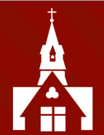
Welcome to
Year 2
Curriculum
Information

Slide 2

Year 2 Team
Miss Gilmore
Mrs Allaway
Mrs West
Mrs Shaw
Miss Henderson
Mrs Edhouse

Slide 3
Weekly Timetable
 | 8.50 | 9.00-9.30 | 9.30 – 10.15 | 10.15 | 10.30 | 10.45 – 11.40 | 11.40 – 12.00 | 12.00 | 1.00 | 1.30– 3.15
Monday Assembly Value | Registration | Assembly | English | Break | Snack | Maths | Mastering Number | Lunch | Class Novel | Foundation subject | PE
Tuesday Assembly Church team |  | Assembly | English |  |  | Maths | Mastering Number |  |  | Foundation subject | PE
Wednesday Assembly Singing |  | Assembly | English (comprehension) |  |  | Maths | Mastering Number |  |  | Computing | Music
Thursday Sharing/OPAL |  | Assembly | English |  |  | Maths | Mastering Number |  |  | Foundation subject
Friday Assembly Achievement |  | Spelling | English |  |  | Maths | Mastering Number |  |  | Assembly | PSHE

Slide 4
Home Learning
Reading books sent home on a Tuesday and should be returned the following week. Please read daily with your child at home.
The children should focus on the New Curriculum spelling list (years 1 and 2). I will add weekly spellings on seesaw to practice for upcoming quizzes.
Maths homework
- Mastering number (Autumn)
- Numbots (Spring)
- Times Table Rock Star TTRS (Summer).

Slide 5
Reading
Encourage your child to read every day
Please read WITH your child at least two or three times a week, checking for understanding and then sign in the ‘Reading Record’ for us to see
Reading books to be changed on a Tuesday
Please also read TO your child
A list of recommended reading for Year 2 is on the school website

Slide 6
Spelling
In KS1, we teach and set weekly spellings to learn at home. Progress is monitored through low stakes spelling tests. We aim for children to improve their own spelling ability and their test scores are not compared with their peers. We feedback to parents following a planned spelling test and provide guidance on next steps if necessary.
The words we teach are directly related to the phonics teaching in Year 2 and comprise high frequency words, the Year 2 curriculum spellings, and the Year 2 common exception words.

Slide 7
Mastering Number at Home
We will be sending ‘Mastering Number at Home’ activities home soon, on Friday 11th October.
Their ‘Mastering Number at Home’ folder will need to be returned every Thursday.
We know you have received a parent workshop in Reception and Y1. Therefore, there will not be one for Y2. If you do still have any queries when you child brings the work home, please message on Seesaw or speak with me at the end of the day.

Slide 8
Snacks & Lunch
The government provide fresh fruit/vegetables for the children’s snack each day.
If your child would like to bring in their own snack, this must be fresh fruit/vegetables. Please provide this in a named, reusable pot/container.
The government also provide every child in Key Stage 1 with a free school dinner. These must be pre-chosen at home, and we encourage you to involve your child in the decision making for this. If your child prefers, they may bring in a packed lunch from home as an alternative.

Slide 9
General Matters
Water bottles should be brought into school every day. Please do not put these in your child’s book bag as this leads to school books becoming water damaged.
PE kit can be worn to school on the days that your child has PE and/or the days they attend a sporting after school club.
We may, on occasions, ask you to send your child into school with welly boots and/or a change of footwear. This will usually be when we are planning to visit the common.
Coats should be worn/brought to school every day, except during the very warm summer months. The children play outside every day in all weathers and some of our learning happens outdoors. Therefore, coats are essential.

Slide 10
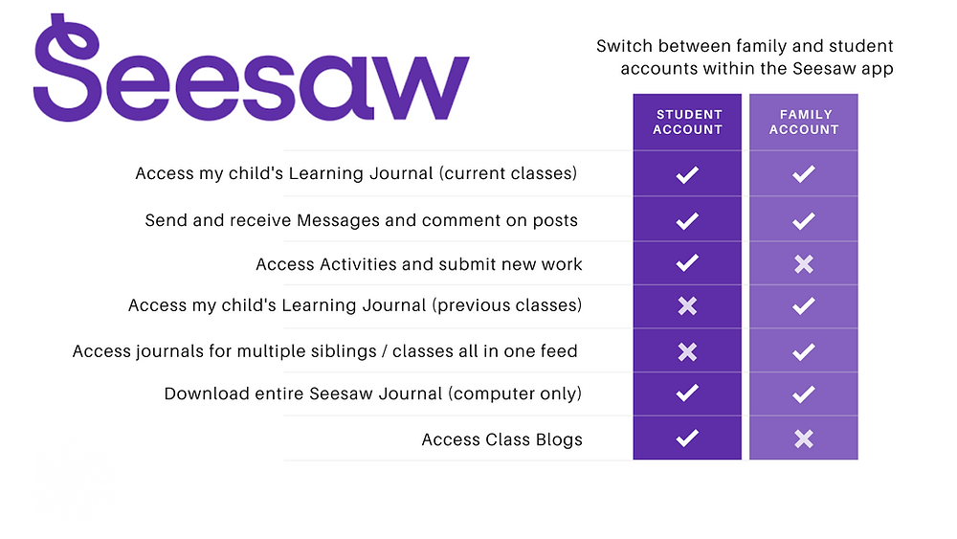
Seesaw is the online learning journal that we will use in every class from Nursery-Year 6. This platform allows us to record learning digitally, set homework tasks to be completed by your child, and provides a home-school connection; families can communicate with their child’s class teacher through the app/account, and teachers can post announcements for family updates. There are two accounts available for Seesaw and you should familiarise yourself with these, so that you choose the correct one for use as a family member.
You have been sent an invitation to connect to your child’s class Seesaw account and, once approved by your child’s class teacher, you will be able to view your child’s learning journal.
Please note, we ask you to use the Seesaw message function respectfully and to only use this to communicate on your child’s learning journey. If you need to communicate with your child’s class teacher for any other reason, please send an email via the school office. admin@christchurchschool.herts.sch.uk
Individual child codes must be used to upload photographs of homework and any other home learning you would like to share with us. A printed QR code has (or will be) provided by the class teacher(s).

Slide 11
Potential School Enrichment
During your child’s time in Year 2, we will arrange activities to enhance and enrich their learning experiences.
This will include local walks, sporting activities, trips, and in-school activities
In the spring term, we plan to take the children to the Roald Dahl museum where they will enjoy a workshop and a walk to see some of the places mentioned in his books.

Slide 12
Voluntary Contributions
We ask for a voluntary contribution of £10 per term (£30 for the year) per child. This is used to cover various materials such as cooking, art and DT.
Without these voluntary parental contributions, we are limited in what we can offer the children in terms of art, DT, and any other activity that requires us to annually purchase consumable items.
Your contributions are gratefully received and appreciated.

Slide 13
Dates for your diary
Parent consultation evenings - In-person on Wednesday 16th October 4-7pm, and Thursday 17th October 5-8pm. Bookings go ‘live from Friday 4th October.
Mastering Number at Home starting – Friday 11th October
Nativity – Thursday 5th December 2pm

Slide 14

PSA
Thursday 3rd October
8pm online
Hear about the School’s exciting development plan
Find out what we are funding

Slide 15
Mobile Phones – Parents/carers & Visitors
Please remember that mobile phones are not permitted to be used inside the school building by parents/carers and/or visitors when school is in operation, including during after-school clubs.

Slide 16
Thank you for taking the time to watch and listen to this presentation. Please ask us for any further information.

