Slide 1
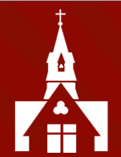
Welcome to
Year 1
Curriculum
Information Evening

Slide 2

Year 1 Team
Mrs Allaway
Mrs Smith
Mrs Young
Miss Rigg

Slide 3
Home Learning
Reading books will be sent home on a Monday or Tuesday and should
be returned the following Monday, to be changed. Please ensure books are kept in bookbags to allow us to read with your child at school.
Spelling sheets will be sent home weekly on a Monday. We will begin by learning to spell the first 100 high frequency words, before moving on to learn to spell additional common exception words, numbers in words, days of the week and months of the year. There is a strong focus on handwriting so please encourage your child to use the correct letter formation when completing these sheets. Please submit spelling homework via a photograph on Seesaw.
We will be sending ‘Mastering Number at Home’ activities home soon, following the parent workshop which will be held on Thursday 10th October at 9am in the Year 1 classroom.

Slide 4
Weekly Timetable
 | 8.50 | 9.00-9.15 | 9.15 – 10.15 | 10.15 | 10.30 | 10.45 – 11.40 | 11.40 – 12 | 12.00 | 1.00 | 1.00– 3.15
Monday Assembly Value | Registration | Assembly | Maths | Break | Snack | English/Topic | Spellings | Lunch | Registration | Handwriting Child initiated learning
Tuesday Assembly Church team |  | Assembly | English |  |  | English/Topic | Phonics |  |  | Focused group tasks Child initiated learning Music
 |  | Assembly | Maths
Wednesday Assembly Singing |  | Assembly | Maths |  |  | English/Topic | Phonics |  |  | PE PSHE
Thursday Sharing |  | Assembly | Maths |  |  | English/Topic | Phonics |  |  | Computing Child initiated learning
Friday |  | Assembly | Maths |  |  | Reading comprehension & library | Phonics |  |  | Achievement assembly EYFS & KS1 PE

Slide 5
Snacks & Lunch
The government provide fresh fruit/vegetables for the children’s snack each day.
If your child would like to bring in their own snack, this must be fresh fruit/vegetables. Please provide this in a named, reusable pot/container.
The government also provide every child in Key Stage 1 with a free school dinner. These must be pre-chosen at home, and we encourage you to involve your child in the decision making for this. If your child prefers, they may bring in a packed lunch from home as an alternative.

Slide 6
General Matters
Water bottles should be brought into school every day. Please do not put these in your child’s book bag as this leads to school books becoming water damaged.
PE kit can be worn to school on the days that your child has PE and/or the days they attend a sporting after school club.
We may, on occasions, ask you to send your child into school with welly boots and/or a change of footwear. This will usually be when we are planning to visit the common.
Coats should be worn/brought to school every day, except during the very warm summer months. The children play outside every day in all weathers and some of our learning happens outdoors. Therefore, coats are essential.

Slide 7
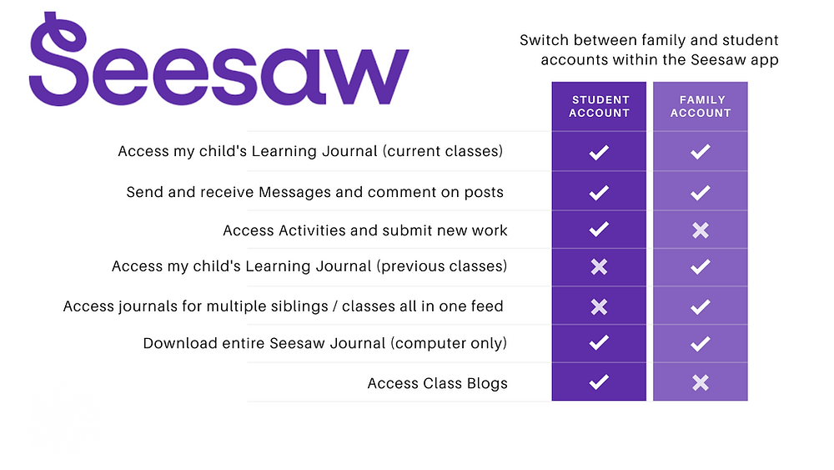
Seesaw is the online learning journal that we will use in every class from Nursery-Year 6. This platform allows us to record learning digitally, set homework tasks to be completed by your child, and provides a home-school connection; families can communicate with their child’s class teacher through the app/account, and teachers can post announcements for family updates. There are two accounts available for Seesaw and you should familiarise yourself with these, so that you choose the correct one for use as a family member.
You have been sent an invitation to connect to your child’s class Seesaw account and, once approved by your child’s class teacher, you will be able to view your child’s learning journal.
Please note, we ask you to use the Seesaw message function respectfully and to only use this to communicate on your child’s learning journey. If you need to communicate with your child’s class teacher for any other reason, please send an email via the school office. admin@christchurchschool.herts.sch.uk
Individual child codes must be used to upload photographs of homework and any other home learning you would like to share with us. A printed QR code has (or will be) provided by the class teacher(s).

Slide 8
Potential School Enrichment
During your child’s time in Year 1, we will arrange activities to enhance and enrich their learning experiences.
This will include local walks, sporting activities, trips, and in-school activities, such as arranging author visits and setting up a maths café.
In the summer term, we plan to take the children to Mountfitchet Castle where they will have an immersive medieval experience.

Slide 9
Voluntary Contributions
We ask for a voluntary contribution of £10 per term (£30 for the year) per child. This is used to cover various materials such as cooking, art and DT.
Without these voluntary parental contributions, we are limited in what we can offer the children in terms of art, DT, and any other activity that requires us to annually purchase consumable items.
Your contributions are gratefully received and appreciated.

Slide 10
Mobile Phones – Parents/carers & Visitors
Please remember that mobile phones are not permitted to be used inside the school building by parents/carers and/or visitors when school is in operation, including during after-school clubs.
We respectfully ask that you are not using your mobile phone at the point when we handover your child at the end of the day.

Slide 11
Parent Volunteers
We are always looking for volunteers willing to support us in school with book changing and to hear children read. If you would like to volunteer to read with children at school, please sign up on the sheet tonight.
Your details will be held on a central volunteering record, and you could be asked to volunteer in any year group
We may be inundated so please don’t be offended if you don’t get called up!

Slide 12
Dates for your diary
Parent consultation evenings – In-person on Wednesday 16th October 4-7pm, and Thursday 17th October 5-8pm. Bookings go ‘live from Friday 4th October.
Mastering Number Home workshop – Thursday 10th October.
Nativity Play – Thursday 5th December at 2pm.

Slide 13

PSA
Thursday 3rd October
8pm online
Hear about the School’s exciting development plan
Find out what we are funding

Slide 14
Thank you for taking the time to listen to this presentation.
Please ask if you have any further questions.

