Slide 1
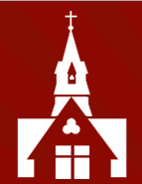
Welcome to the Reception Class
Curriculum
Information Evening

Slide 2

Reception Team
Mrs Allaway
Mrs Booth
Mrs Young
Mrs Bromell

Slide 3
Settling in & communication
We know that starting school is a big change for lots of children and that this can be a time of anxiety for parents. We would like to reassure you that we will communicate with you if we notice your child is unsettled, or if they do not appear to be eating much in school.
If you don’t hear from us, you can assume that from our observations, everything is fine with your child in school.
We purposely set a date early in the term for Early Years and Key Stage 1 parent consultations, as we know that parents appreciate some feedback on how their child is presenting in school. The dates for this have been set and you will receive sign-up details closer to the dates, which are:
Wednesday 11 October, 4-7pm & Thursday 12 October, 5-8pm
You will be offered a 10-minute appointment with Mrs Booth and Mrs Allaway, and this will take place in person, in school.

Slide 4
Photograph permissions
We have been asked if we would like to send a ‘starting school’ photograph of the children in Reception to the Watford Observer.
We would like to do this but before we do, we would like to seek clarification on some of the ‘No’ ticks on the photograph permissions submitted to the office. Please see one of us at the end of this presentation if you have indicated ‘No permission’ in any of the boxes on your child’s permission sheet.
If you would prefer your child not to be photographed, we will ensure they are not included.

Slide 5
Learning in Reception
We follow the statutory ‘Early Years Foundation Stage’ (EYFS) framework guidance for children between the ages of zero to five years old. Towards the end of the Reception year, teachers will assess whether your child has reached the seventeen Early Learning Goals within this framework.
The EYFS consists of seven areas of learning and development:
Prime areas
Communication and Language
Physical Development
Personal, social and emotional
Specific areas
Literacy
Mathematics
Understanding the world
Expressive arts and design

Slide 6
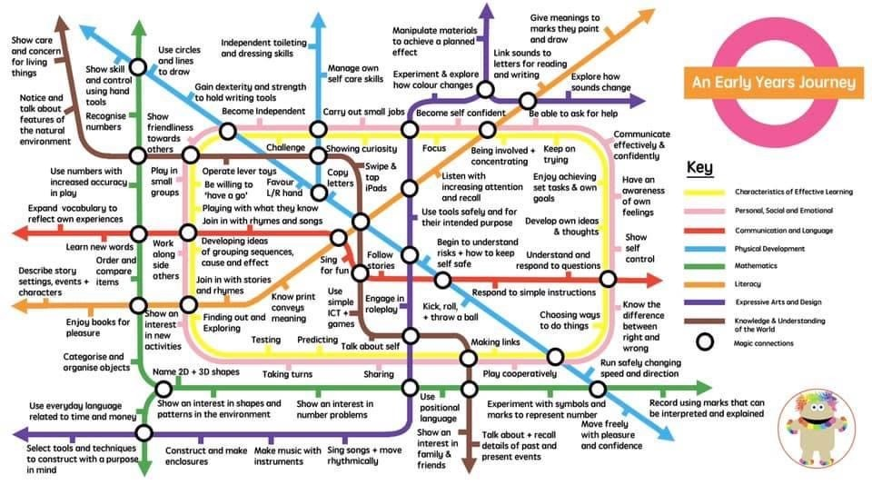
An overview of EYFS

Slide 7
Teaching approaches
Learning in Reception takes place through topics and high-quality texts to ensure a broad and rich curriculum. The topics will be changed several times throughout the year and will be, to some extent, led by the children’s interests and their next steps in learning.
Within our continuous provision, there will be a wide variety of learning activities and resources laid out for the children to access independently. Alongside this, we will run adult-led activities in small groups.
To allow a child-led approach that ensures engagement and motivation, staff will continuously observe to see where the children’s interests lie. The staff will observe, plan and adapt the topics accordingly to meet the needs of the class.
We strive to promote the ‘characteristics of effective learning’ that are promoted and valued in EYFS. These include engagement through ‘playing and exploring’, motivation through ‘active-learning’ and ‘creating and thinking critically’.
We endeavour to use a holistic approach to learning and development as we understand the importance of children feeling happy and secure before effective learning can take place.
The end of year transition into Key Stage 1 is viewed this as a process rather than an event and we carefully plan and communicate on this with the Year 1 staff to ensure that the children are supported carefully through this.

Slide 8
Reading and Phonics
To ‘hook’ the children at the start of a topic, high quality, vocabulary rich texts are carefully chosen so that a range of genres are introduced to the children.
We teach daily phonics lessons and will run interventions for any child who is not acquiring phonic awareness at the expected rate.
We send home reading books that are directly linked to the phonics being taught in the classroom, ensuring they are appropriate for each individual child’s reading and comprehension level.
We ask that you prioritise reading at home with your child, as no other home learning is regularly set for this age group.
Your child will read with an adult at least once a week and this may happen on any day of the week; your child’s books will be changed at the same time.
Reading books will be sent to you over the next few weeks, once we have covered enough sounds in class. If your child can already read, we will assess them to see what level they are at.
We will send home a set of the first 100 high frequency words, which children should learn to read by decoding or on sight.
A separate presentation will be sent out to provide you with more details about our chosen phonics scheme of work, Floppy’s Phonics.

Slide 9
Maths Mastery
We teach using a ‘Maths Mastery’ approach across the whole school from Nursery to Year 6.
This approach places great importance on children developing a deep understanding of numbers and the number system.
It aims to develop maths fluency without the need for children to rote-learn or to memorise procedures.
Maths is taught at a slower pace, allowing for deeper understanding, with lots of opportunities to apply their understanding in real-life and play contexts.
All children achieve, and able mathematicians can be challenged appropriately through extension work.

Slide 10
Home learning & supporting your child’s learning in school
One of the most impactful ways that you can support your child at home is by helping them to develop a greater level of independence. At home they may be able to get a lot of support from you or from other family members but, in school, they need to be willing and able to do lots of different things by themselves. We would like you to support your child to achieve the following:
To get themselves dressed and undressed, including their school jumper and their school shoes.
To put on and zip up their coat by themselves.
To use the toilet and wash their hands without the support of an adult.
To become increasingly independent when using a knife and fork to cut up and eat meals.
To carry their own school belongings to and from school, finding ways to make this as manageable as possible.

Slide 11

Seesaw learning journal
Seesaw is the online learning journal that we will be using in every class from Nursery-Year 6 this year. This platform allows us to record learning digitally, set homework tasks to be completed by your child, and provides a home-school connection; families can communicate with their child’s class teacher through the app, and teachers can post announcements for family updates.
Please note, we ask you to use the Seesaw message function respectfully and to only use this to communicate on your child’s learning journey. If you need to communicate with your child’s class teacher for any other reason, please send an email via the school office.

Slide 12
General information
Our PE days are Wednesday & Friday; children should come to school in the PE kit and should wear trainers. Velcro fastenings only, please.
Book bags need to come to school every day and should contain your child’s reading books every day as we cannot predict which day they will be heard read.
A healthy fruit or vegetable mid-morning snack is provided by the government’s fruit and vegetable scheme. We do not know what we will be sent each week, and this varies greatly. If your child does not like certain fruits or vegetables, then we recommend that you send a fruit or vegetable snack into school with them. Please ensure your child is aware that they have this in their bag as we do not have time to go through the book bags each day.
Every child needs a named bottle of water in school with them every day. Please choose one with a sport’s cap lid as this helps us in limiting spillages on the carpet. WATER BOTTLES MUST NOT BE CARRIED INSIDE THE CHILDRENS’S BOOK BAGS as this causes water damage to our reading books. Water damage caused in this way will incur a fine to cover the cost of replacing damaged books.

Slide 13
General information
School dinners are provided free for Reception aged children; please ensure that you login regularly to ensure your child has a lunch chosen for them each day. Please chat to your child so they know what to expect for their lunch each day.
Every item of clothing & footwear that your child wears to school MUST BE NAMED!
Please ensure that your child is appropriately dressed for the school each day and that they bring a coat, or a rain jacket every day in case of changeable weather.
Please provide a change of clothing that can stay on your child’s peg. We have spare clothing we can offer if required but this stock is limited.

Slide 14
Mobile Phones – Parents/carers & Visitors
Please remember that mobile phones are not permitted to be used inside the school building by parents/carers and/or visitors when school is in operation, including during after-school clubs.

Slide 15
Enrichment opportunities
We plan exciting and interesting experiences in Reception that enhance the children’s learning. This includes opportunities to grow their own food, cooking, craft & sewing activities, play dough ingredients, visitors to give talks, and so much more. We do not necessarily plan these too far in advance as often they are linked to the children’s current learning and interests.
We are only able to provide these wonderful enrichment experiences if parents make a voluntary contribution of £10 per term or £30 for the year; this allows us to buy resources that are not included within our government provided curriculum funding.

Slide 16
Forest School
We have decided that this term’s Wednesday PE session will be ‘Forest School’ opportunities for the children. We will focus on exploring the woods through walks and opportunities to play and climb.
Children should come to school in their PE kit with their legs covered – no shorts or skorts on this day.
As the weather changes, we will need wet weather overalls and welly boots but please do not buy these yet as we are still sorting through our donations, and we may already have enough in school.
As the term progresses, we will also introduce PE in the hall, which will focus on dance & gymnastics.

Slide 17
Additional dates for your diary
You are warmly invited to attend the new entrants service of blessing on Thursday 21 September, at 9.30am, in church.
We encourage you to attend the phonics and reading workshop for parents on Thursday 5 October, 2.30-3pm, in school.
On Thursday 7 December, 11am, we welcome you to join us in school to see the children perform the Early Year’s Nativity.

Slide 18
Parent Volunteers
If you would like to volunteer to read with children at school, please sign up on the sheet tonight
Your details will be held on a central volunteering record, and you could be asked to volunteer in any year group
We may be inundated so please don’t be offended if you don’t get called up!

Slide 19

PSA
7pm 21 September School Hall
Hear about the School’s exciting development plan
Find out what we are funding
Cheese & wine social

Slide 20
Thank you for taking the time to watch and listen to this presentation. Please ask us for any further information.

